Slide 1

corporate's deterrent: attrition rates in your firm
User Manual
Author: Nirvaan Singla
Notes:
Preworks course home assignments

Slide 2
Table of Contents
S.NO | TOPIC
1 | acknowledgements
2 | About me
3 | About my internship journey with clevered
4 | About app
5 | How do I use the app?
6 | Options and steps to use
7 | Contact person

Slide 3
Acknowledgements
I would like to acknowledge and express my special thanks to Dr. Ken Khan, whose guidance and mentorship throughout the internship motivated me to tackle all obstacles and successfully complete this project. I would also like to thank Dr. Shivani Srivastava and the clevered internship team, who provided invaluable insights regarding various components of my project and helped me improve its working as a whole, along with ensuring a smooth development process. Furthermore, I would like to extend my gratitude to my friends and family for their constant support throughout the duration of the internship.

Slide 4

About Me..
Greetings! My name is Nirvaan Singla. I am a student of Modern School Barakhamba Road, New Delhi, where I study Physics, Chemistry, Mathematics ,Economics and English. Apart from my commitment to showing consistency in my academic performance, I also have a deep interest in technology. I love to play with computers and programs and try my hand at creating new things. I have furthered my study of this exciting field by learning different programming languages like Python and Java and implemented my skills into practice by interning under Mr. Ishan Mittal, a software engineer having work experience with numerous multinational corporations like Samsung Electronics, Calsoft, Incendo, etc. Under his mentorship, I and a team of 5 students from different parts of India created a network of fitness apps in May 2021 in order to materialize the concept of digital fitness emerging at that time and facilitate people’s access to fitness guidance from the comfort of their homes.

Slide 5
About Me..
Furthermore, I have also worked with Dr. Beverly Thurber of Northwestern University to analyze data using computational tools in order to create mathematical models on a variety of issues like the rate of spread of COVID-19 in the US, the trends in Democratic decline in India, etc. during the accelerated summer program in mathematical modelling offered at the university during June 2022. During my rigorous and rewarding internship with clevered, I have created an attrition rate predictor which would allows firms to predict the possible trends in attrition among their employees. Addressing the challenges firms across the world face due to the ever-changing geo-political order, the highly unstable economic growth patterns and the decreasing productivity of employees after the lockdown due to the COVID-19 pandemic and the emerging concept of “Quiet-Quitting”, I believe that this attrition rate predictor will allow companies to analyze their situation and take actions accordingly, as well as to decide which policies are best for their employees and which are not. This in-turn will spare them significant losses incurred as a result of attrition.

Slide 6
About My Internship Journey with Clevered..
My internship journey with clevered has been like no other. Playing with mind-expanding machine-learning models, deeply-engaging graphic designs and diverse datasets has been an extremely enjoyable endeavor for me. Furthermore, the team’s constant support and ever-accommodating mindset motivated me to keep working with high enthusiasm and helped me to tackle all the challenges I faced while programming with ease. Furthermore, I will always treasure the valuable life lessons of teamwork, discipline and consistency that I learnt while working with my mentors. To sum it up, from life-lessons to machine learning and utmost discipline to a friendly environment, my internship journey with clevered has been an extremely enriching adventure, one which will find its place in the deepest corner of my heart and mind for years to come.

Slide 7
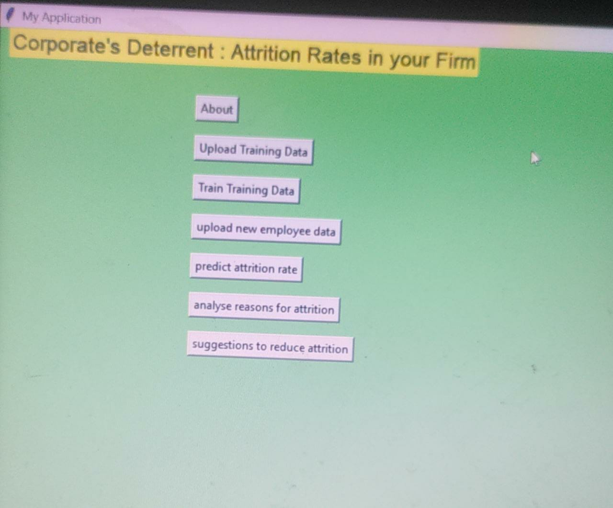
About The App..
‘Corporate’s deterrent: attrition rates in your firm’ allows firms to predict the attrition rates within their organization on the basis of their employees' trends. The user may upload his/her firm’s employees’ data, after which the app will observe the trends and predict the attrition rate within the organization. Furthermore, the user may also analyze the reasons for the current attrition rates in his firm using the app’s analyzing tools and check suggestions to reduce this attrition rate on the basis of the analysis.

Slide 8
How do I use the App?
In order to use the app, the user simply has to upload the data on the platform and use the buttons to obtain information as per his/her needs. The instructions to use each button have been mentioned in the next slide.

Slide 9
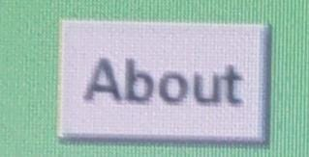
Options and steps to use
this button is included to give you a quick brush-up of the steps to use this application in a sequential order, as well as to mention minute details to be kept in mind while using the application

Slide 10
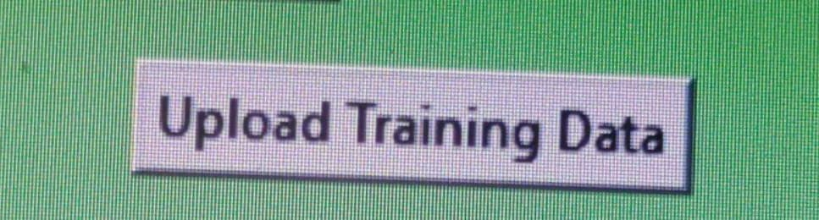
Options and steps to use
Upon clicking this button, user will see the option to upload any document from his/her files. He/She may then select any file which contains data regarding the employees in his/her organization and upload it using the ‘open button as shown on his/her screen(please note that the training dataset needs to be uploaded using this button). It must be noted that the data should contain certain parameters like employee ID, Department, Job Role, Gender, Age, Marital Status, Experience, Monthly Salary, Business Travel and distance from home. Moreover, it is preferred that the data be presented in excel form. Please refer to the following sample as an acceptable form of dataset for analysis by the app: "https://confrecordings.ams3.digitaloceanspaces.com/previous_data.csv"

Slide 11
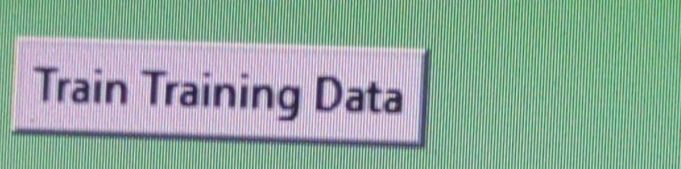
Options and steps to use
This button is to be used for training the dataset, prior to predicting the attrition for the testing dataset.

Slide 12
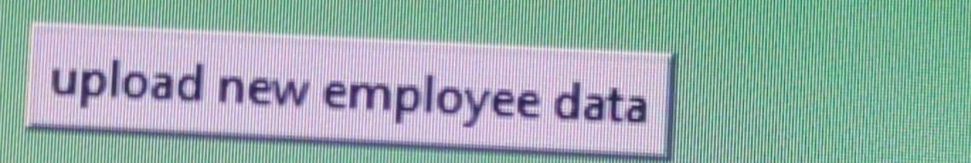
Options and steps to use
Upon clicking this button, user will see the option to upload any document from his/her files. He/She may then select any file which contains data regarding the employees in his/her organization and upload it using the ‘open button as shown on his/her screen(please note that the testing dataset needs to be uploaded using this button). It must be noted that the data should contain certain parameters like employee ID, Department, Job Role, Gender, Age, Marital Status, Experience, Monthly Salary, Business Travel and distance from home. Moreover, it is preferred that the data be presented in excel form. Please refer to the following sample as an acceptable form of dataset for analysis by the app: "https://confrecordings.ams3.digitaloceanspaces.com/current_data.csv"

Slide 13
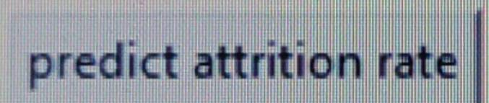
Options and steps to use
After the user has uploaded his/her employee data, he/she may click on this button to check the attrition rates on the basis of the dataset uploaded. The app will analyze the data and predict the attrition rates on the basis of the information given under different parameters. The button will redirect the user to another page which will show him/her the attrition rate in his/her organization a few places above the bottom, along with the process by which it was calculated. Furthermore, the page shall also show the confidence level in the statistical findings. This may help the user to analyze the findings accordingly. Moreover, the attrition rates of a sample dataset have been displayed for the user’s convenience, in order to know what to expect. The findings can change as per the latest dataset uploaded. Please note that even though this is supposed to be a speedy process, it might occasionally take some time for the program to present its findings. This may be due to the size of the file uploaded or if any missing values are present in the dataset. Nevertheless, the findings shall be displayed within a suitable timing.

Slide 14
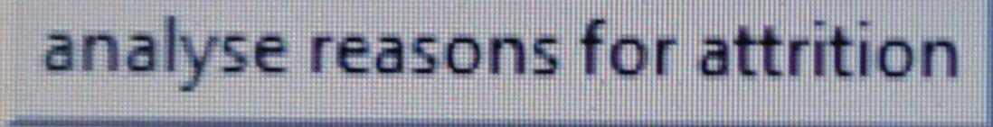
Options and steps to use
After the user has predicted the attrition rates within his/her firm, he/she may then click on this button, after doing so, he/she will be redirected to a page which will graphically display the reasons for the current attrition rate. The user may then save this information on any other application for future reference. Please note that while the reasons may be stated, they are not saved on the app. Once another dataset is uploaded and analyzed, the information for the previous dataset will be cleared automatically. Hence users are advised to separately note down the information displayed on the app before moving on to another dataset. This precaution also applies to the other three buttons.

Slide 15
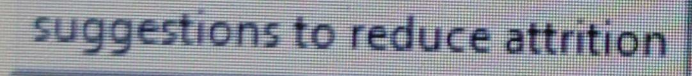
Options and steps to use
After the user has analyzed the reasons for attrition, he/she may click on this button to check the suggestions to reduce attrition among the organization's employees. These recommendations shall be presented on a new page, following the same procedure as the previous button However, please note that these recommendations are computer-generated with no human interference, and hence may be subject to consideration for reference depending upon the firm’s unique circumstances. The same precaution applies to the previous button also. Both these commands are computer generated and hence may present standardized responses.

Slide 16
Contact Person
In case of any queries, please reach out to me at:
Email address: nirvaan4871@gmail.com
https://github.com/NirvaanSingla/Coporates__Detterent_Attrition_Rates-_In_Your_Firm.git

Slide 17
Toolkit
Github link:
https://github.com/NirvaanSingla/Coporates__Detterent_Attrition_Rates-_In_Your_Firm.git
App development toolkit:
"C:\Users\HP\Downloads\AI-App Development Toolkit Workbook (1).HTML (1).xlsx“
Linkedin link:
https://www.linkedin.com/pulse/corporates-deterrent-attrition-rates-your-firm-nirvaan-singla/?trackingId=4wDlkbFU4apwLHBKcTXBkw%3D%3D
Youtube video link: https://www.youtube.com/watch?v=YWu7AadXKhh

Slide 18
Thank you!

